Slide 1

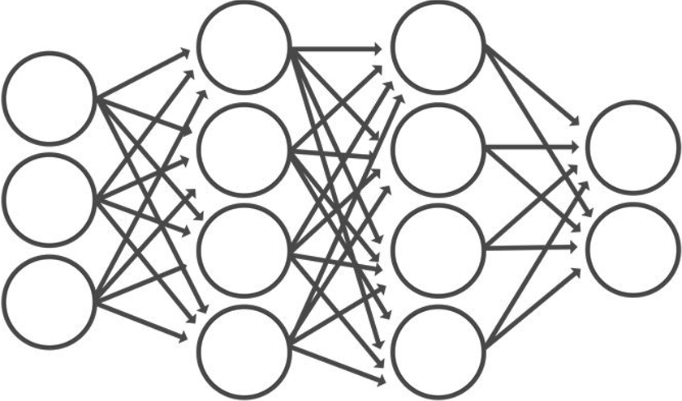
[0]
[1]
[2]
[3]
[4]
Data
CNN Model
Class
Notes:
CNN Model

Slide 2
2nd Question for Biology 1 of The Korean CSAT 2022
2. The table shows the waste products generated as a result of cellular respiration using nutrients α, β, and fats. α and β represent proteins and carbohydrates in no particular order.
Text
nutrients | waste products
α | water, carbon dioxide
β | water, carbon dioxide, ⓐ ammonia
fats | ?
Class
"Which of the following statements about this is correct?“
A) Nutrient α represents proteins because proteins produce carbon dioxide and water.
B) Nutrient β represents carbohydrates because carbohydrates produce ammonia as a waste product.
C) Fats produce only water and carbon dioxide as waste products.
D) Nutrient α represents carbohydrates because carbohydrates produce carbon dioxide and water.
[0]
[1]
[2]
[3]
[4]

